Slide 1
Los Angeles US Air Force Academy Workshop
Welcome
Please Take a Seat We will Begin Soon
Notes:
Introductions

Slide 2
The Los Angeles US Air Force Academy Workshop
Welcome
Doors will open at 7:45 AM
Notes:
Introductions

Slide 3
The Los Angeles US Air Force Academy Workshop
Welcome
Colonel Steve Staso
Liaison Officer Director
US Air Force Academy Admissions - Los Angeles
Notes:
Introductions

Slide 4
Today’s Staff
Colonel Bill Marshall
Colonel Steve Pluntze
LtCol Bob Kay
Major Catherine Christ
Major Carl Ferraris
Major Tim Massino
Major Jonwa Kim
Major Tim Massino
Major Mario Phillips
Capt Tom Buenger
Capt Julius Puentes
Ms Marilyn Fitzgerald
Mr Ed Fitzgerald
Ms Nancy Wilson
Dr Ross Dueber
Ms Ellie Kay
USAFA Admissions
Col Carolyn Benyshek
Ms Gay Harrison
Ms Patty Edmond
Ms Bonny Madison
Ms Terri Regan
Ms Kim Land
LtCol Steaven Meyer
USAFA AOG
Mr Bill Preston
Front Desk
Nancy Wilson
Carl Ferraris
Facilities and logistics
Emergencies
Restrooms
Food, water, lunch
Phones

Slide 5
Assignment #2
Why Do I want to become an Air Force Officer?
What people in my life can help me understand and improve my criteria for USAFA Admissions?
What can I do Now and and Through High School to prepare?

Slide 6
Agenda
MORNING SESSIONS
0800 – Introductions
0810 - Welcoming Remarks
0830 - USAFA Review
0845 – USAFA Admissions
– USAFA Selections
0945 – Military Service Academies
1000 - Candidate Fitness Exam (Students—Gym/Track)
- Parents Briefing (Parents)
1130 – 1230 Group A - Assessments/Networking Group B - Lunch
12:30 – 1330 Group A - Lunch Group B - Assessments/Networking

Slide 7
Agenda
AFTERNOON SESSIONS
1330 - Congressional Nominations
1400 - Alternative Paths to the Air Force
1415 - The ALO Interview - "Telling Your Story”
1430 - The Leadership Resume - Exercise
1500 - Q/A with Recent USAFA Graduates
1530 – Wrap up, Evaluations, and Adjourn

Slide 8
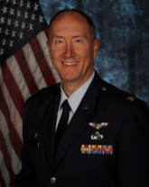
Welcome
Colonel Steve Pluntze
Prior Commander of the Defense Meteorological Satellite Program Systems Group (DMSG)
Test Pilot School – Flight Engineer
Scientist
PhD, Aero Astro
USAFA Instructor
US Air Force Academy Graduate
Currently: Deputy Director of Remote Sensing

Slide 10
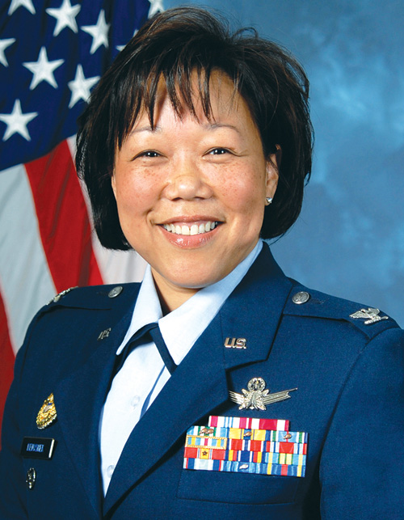
US Air Force Academy
Colonel Carolyn Benyshek
Director of Admissions

Slide 12
Assignment #3
During breaks and lunch, Introduce yourself to at least 3 people and ask them a question.
Use good eye contact, take notes, and move on.
Another student - exchange at least 1 idea on what you are doing to improve your fitness and or SAT/ACT scores.
Reps at the Service Academy tables - learn 2 new things about their academies
ALO and Admissions - ask a question about admissions, careers

Slide 13
Assignment #4
Prepare for your 1:1 Assessment and ALO Interview
Be prepared to advocate for yourself and explain the significance of your accomplishments
Bring pen/paper
Practice communications (introduce self, eye contact); Prepare to Discuss the Honor Code, Core Values
Parents: practice interviewing, role playing
At home: check email/spam, vmail
Learn about USAFA online and from “Instructions to Applicants / Candidates”; develop questions to ask ALO
Learn a little about USAFA daily life

Slide 14
Assignment #5
Report for your 1:1 Assessments
You and your parents Report to this main room a few minutes prior to your scheduled time. Take your Leadership resume or your reason why you don't have one.
You will be directed to a table in the lobby for your 10 minute feedback session.
Students: answer questions and discuss; present your best. No time for Q&A. Pick up the conversation with your ALO. Officer will provide targeted feedback on what you can do to improve the 3 areas we evaluate.
Parents: observe and discuss later
Back in Seats by 1:25

